Slide 1
To Facilitate
lausd.org/human-relations

Slide 2
Would You Rather
Be fluent in all languages
Be a master at every musical instrument
lausd.org/human-relations

Slide 3
Objectives
Discuss the Make a Choice Series and its value in the educational environment
Learn about how to implement the Make a Choice series at your school site
Reflect on potential outcomes for students participating in the Make a Choice series
lausd.org/human-relations

Slide 4
The Why
Humans make thousands of choices a day. Some choices can feel like BIG choices. Other choices we make so often they become routine. Some choices we are making for the first time. Other choices we have been making since we were small.
Make a Choice is a series of lessons aimed at helping students make healthy and well-informed choices.
These lessons are easy to implement and engage students in thoughtful discussions and reflections about the choices they make in their day-to-day lives.
lausd.org/human-relations

Slide 5
Facilitator Requirements
The Make a Choice series is easily implemented by any educator. Ideal facilitator candidates would be those who are:
Certificated staff
Open minded
Present at the school site of implementation at least 3 days a week
Familiar with group dynamics
Available to commit to 6-8 weeks with the same group of students
Skilled at engaging youth in dialogues
Willing to encourage group participation
Prepared to follow up with student participants for progress monitoring
lausd.org/human-relations

Slide 6
Consent
No consent is needed if the Make a Choice series is implemented with an entire class, or during non-instructional time.
Check with your administrator regarding required permissions for pulling students from instructional time.
lausd.org/human-relations

Slide 7
Facilitation
10 Lessons | Approx. Time: 10-minute preview | 30-40 minute lesson
The lessons can be executed in any order, but the ideal order is:
MAC to Make a Choice
MAC to Be an Upstander
MAC to Be a Digital Citizen
MAC to Be Kind
MAC to Learn About Identities
MAC to Ask for Help
MAC to Understand Consent
MAC to Set Goals
MAC to Find Life Balance
MAC to Practice Self Care
lausd.org/human-relations

Slide 8
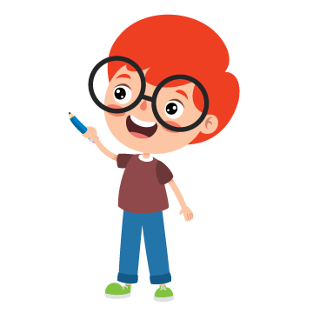
Lesson Format
C
Content, Videos, Discussion Questions
A
Check-in Question
B
Objectives
D
Self Care Check Out
lausd.org/human-relations

Slide 9
CHECK-IN QUESTION
The check-in question provides a quick "ice breaker" to get the students warmed up and ready to engage.
This check-in should take no more than 5 minutes and is meant to remain light.
Be fluent in all languages
Be a master at every musical instrument
lausd.org/human-relations

Slide 10
Objectives
The objectives provide the students with an idea of what the lesson will cover.
Most of the objectives follow the same format: learn, discuss, reflect.
Objectives can be reviewed quickly each session as a way to introduce the lesson.
lausd.org/human-relations

Slide 11
Content, Videos, Discussion Questions
The make up of each lesson is unique, but includes content, videos, and opportunities for reflection.
Facilitators should set aside 10 minutes to:
Review the content for the lesson
Test the videos to ensure proper playback
Ensure you are logged into YouTube with your LAUSD SSO
e-mail humanrelations@lausd.net with any issues
Review reflection questions for the lesson and brainstorm possible example answers you would give
lausd.org/human-relations

Slide 12
Self-care Check Out
Every lesson ends with an opportunity for the students to articulate one way they will choose to take care of themselves that day.
The self-care check out encourages students to learn helpful tools to cope with stress, even if they aren't stressed.
Practicing self-care when we are in a calm state can make those tools more accessible when we are stressed.
Have me-time
Eat healthy meals
Go outside
Do your hobby
Read a hlp book
Talk with your friends
lausd.org/human-relations

Slide 13
Be Kind
lausd.org/human-relations

Slide 14
Would You Rather
Talk to animals
Read peoples minds
lausd.org/human-relations

Slide 15
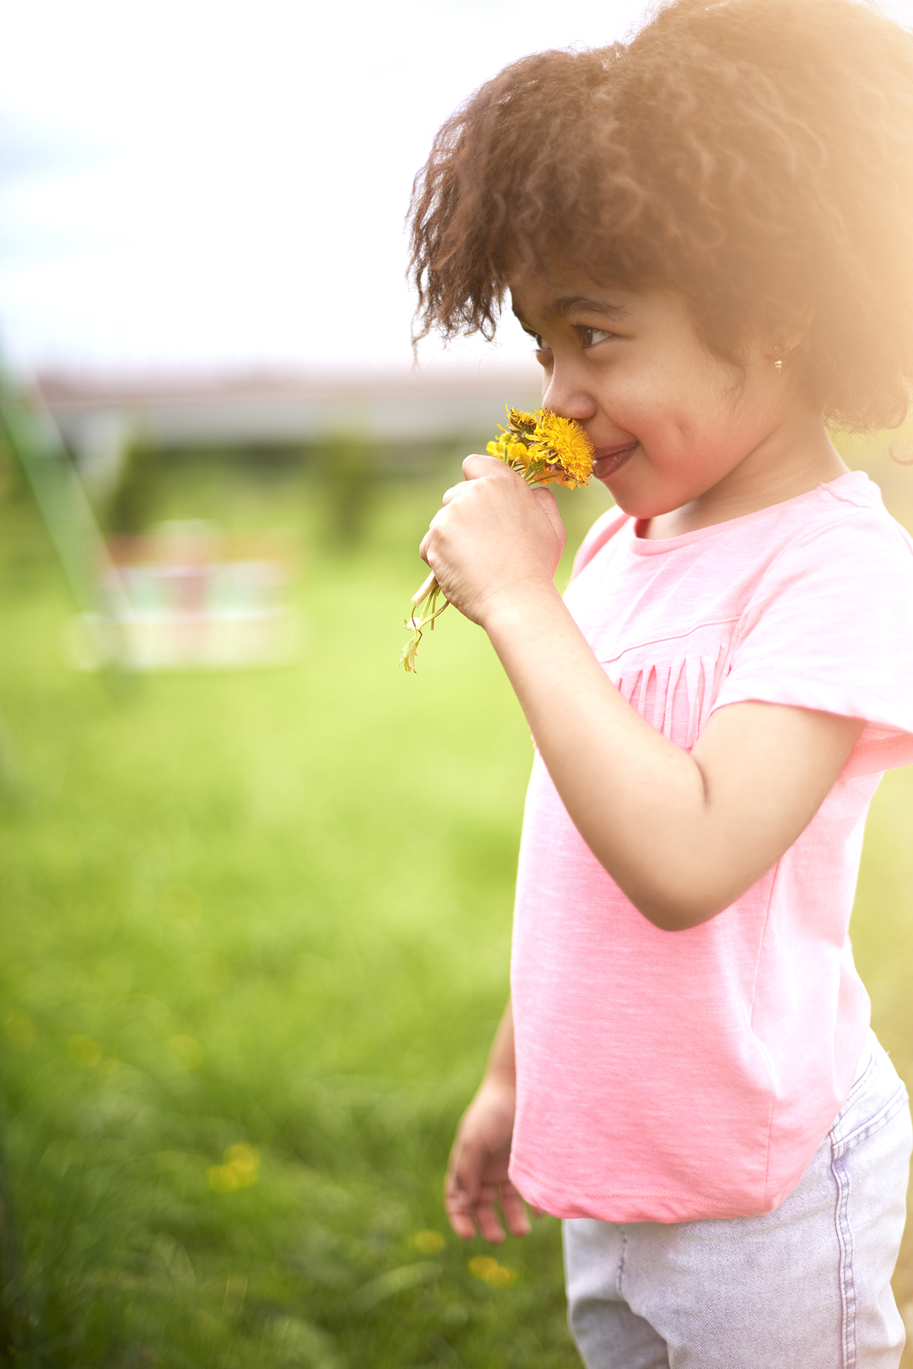
Pair Share
Do you know what kindness is?
lausd.org/human-relations

Slide 16
What is Kindness?
lausd.org/human-relations
Notes:
https://www.youtube.com/watch?v=BNNcpAcF0GM

Slide 17
Make a Choice to Be Kind!
Every day we can make a choice to be kind!
Kindness is doing nice things to show you care.
There are lots of ways to be kind like taking turns, sharing, helping to clean, or even giving hugs (with permission)!
lausd.org/human-relations

Slide 18
Why Kindness?
Did you know that BEING kind to someone else can make YOU feel happier?
In fact, BEING kind helps us to feel more gratitude, and more connected to the people around us!
Also, BEING kind helps reduce our stress!
lausd.org/human-relations
lausd.org/human-relations

Slide 19
Pair Share
If BEING kind can do all of THAT for someone, what do you think it does for the person receiving the kindness
lausd.org/human-relations

Slide 20
What is Kindness?
lausd.org/human-relations
Notes:
https://www.youtube.com/watch?v=mdA2sByFX1I

Slide 21
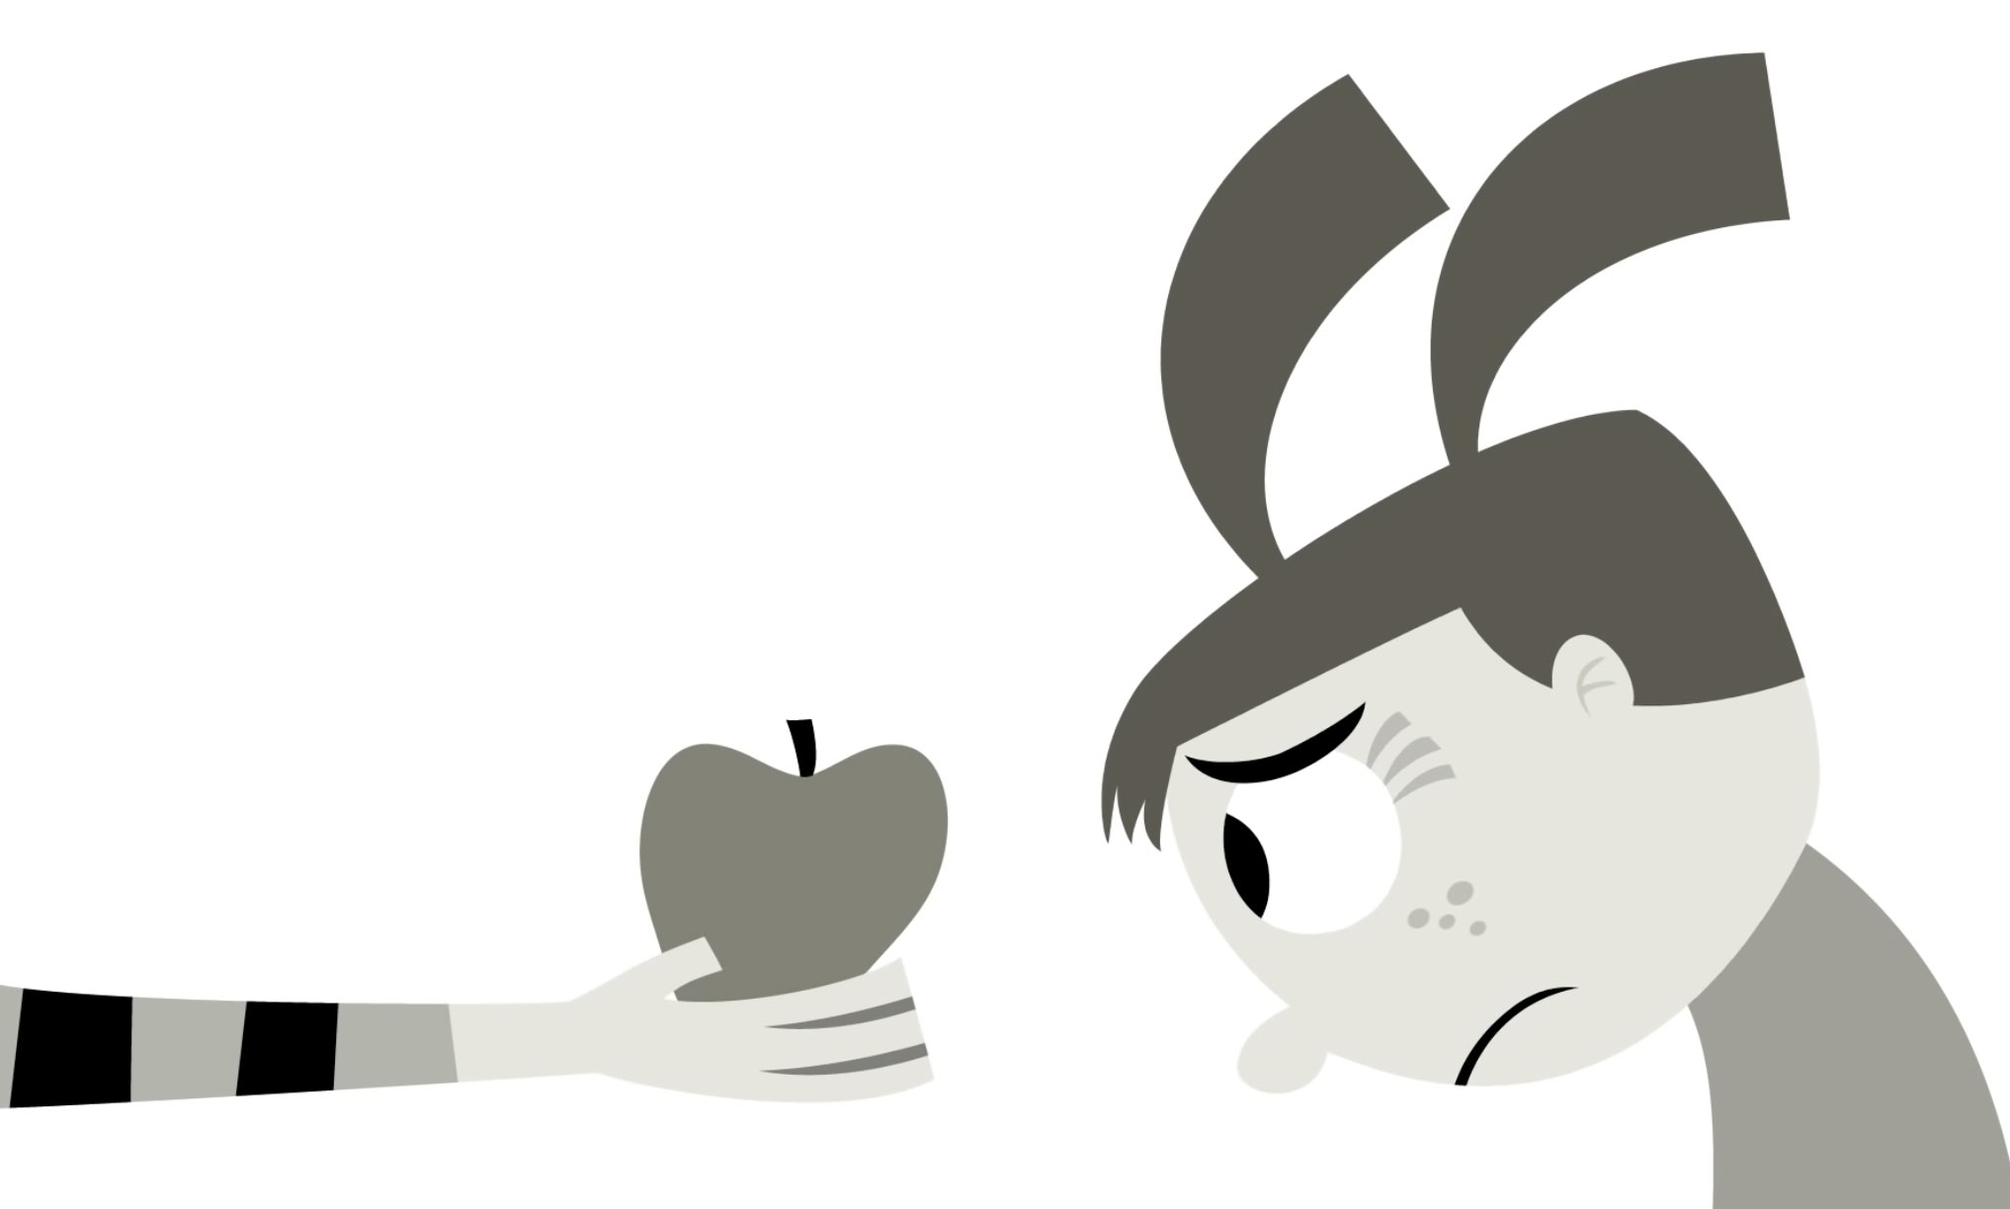
Acts of Kindness
We saw a lot of folks choose kindness in that video!
Let's name a few of the acts of kindness we saw.
lausd.org/human-relations

Slide 22
Choose Kindness
What are some acts of kindness you can choose today?
lausd.org/human-relations

Slide 23
Check Out
What will you do for yourself today?
Take a bath
Listen to music
Read a book
Call a friend
Enjoy nature
Take a nap
lausd.org/human-relations

Slide 24
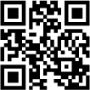
Committed to fostering a safe and respectful District, school and community culture where the seeds of peace and justice are down so that all students and staff can lead safe, purposeful and academically fruitful lives.
Connect with us at bit.ly/LAUSD-HRDE
lausd.org/human-relations

Slide 25
Facilitation
Evaluation
Facilitators must complete a Pre-Implementation evaluation before conducting the series and a Post-Implementation evaluation upon completion.
Students must also complete a Pre and Post evaluations for this series. Best practice would be for the facilitator to provide class/group time to complete the evaluation.
Support
Facilitators are invited to join a drop in/office hours session for additional support.
lausd.org/human-relations

Slide 26
Facilitation FAQs
Q: What grade levels would this be appropriate for?
A. The lessons were created with 4th grade students in mind and can be adapted to meet the needs of your unique students.
Q: Who can teach these lessons?
A. These lessons have been created to be facilitated by any certificated staff (teachers, counselors, PSWs, PSAs, psychologists, etc.). It's recommended that at least one of the facilitators be on the campus three or more days per week in the event that a student may wish to follow up with that staff.
Q: Do I need to have the same students in each lessons?
A: The series is designed to work best with the same group of students in each lesson. This is highly encouraged to review student outcomes and progress.
lausd.org/human-relations

Slide 27
Facilitation FAQs
Q: Where can we locate the lessons?
A. The lessons will be available online, a link will be provided.
Q: Do the lessons need to be taught in order?
The lessons can be taught in any order based on the needs of your class/students.
Q: Do we have to teach all of the lessons?
A: Each lesson has value but educators may pick which lessons they would like to share.
lausd.org/human-relations

Slide 28
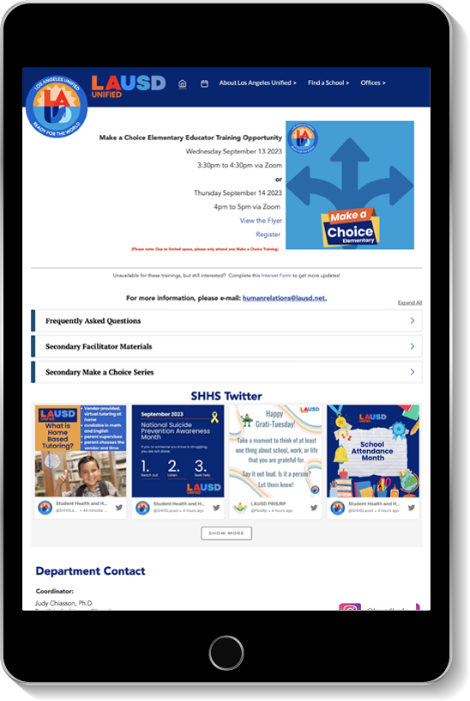
Website
All the materials you need can be found online.
Visit the HRDE Make a Choice website by clicking the link: www.lausd.org/Page/17623
Click on the accordions to view all the resources
lausd.org/human-relations

Slide 29
Help Us Grow
Professional Leadership Group
Who: Teachers who have already received training in the Make A Choice Program and are interested in collaborating on supplemental materials to strengthen the program.
When: The group will meet once a month for 2-3 hours
Will there be compensation? Teachers who participate will receive X Time for their time and effort
How do I apply? Click or scan the QR code to apply.
Applicants will be contacted and selected pending approval of funding.
lausd.org/human-relations

Slide 30
Questions
lausd.org/human-relations

Slide 31
Committed to fostering a safe and respectful District, school and community culture where the seeds of peace and justice are down so that all students and staff can lead safe, purposeful and academically fruitful lives.
Connect with us at bit.ly/LAUSD-HRDE
lausd.org/human-relations

